Slide 1
University of Basrah
Al-Zahraa Medical College
Ministry of higher Education
and Scientific Research
Academic year 2021-2022
5th year
REPRODUCTIVE BLOCK
Lecture: 2
Duration : 1 hour
PCOS
Presented by
Dr.RAYA MUSLIM AL HASSAN
Block staff:
Dr.Raya Muslim Al Hassan (Block leader)
Dr.Marwa Sadik (co leader)
Dr. Abdul kareem Hussain Subber
Dr.Alaa Hufdhi
GYNAECOLOGY 20th
EDITION by Ten Teachers

Slide 2
LEARNING OBJECTIVES
University of Basrah
Al-Zahraa Medical College
Ministry of higher Education
and Scientific Research
Define pcos
how can you diagnose it
What is the main treatment of pcos
Define hirsutism,causes and management.

Slide 3
University of Basrah
Al-Zahraa Medical College
Ministry of higher Education
and Scientific Research
PCOS is a common disorder, often complicated by chronic anovulatory subfertility and hyperandrogenism with the clinical manifestations of oligomenorrhoea, hirsutism and acne.

Slide 4
The Rotterdam criteria:2 out of 3
University of Basrah
Al-Zahraa Medical College
Ministry of higher Education
and Scientific Research
1. polycystic ovaries (either 12 or more follicles or increased ovarian volume [> 10 cm3 ]) .
2. oligo-ovulation or anovulation
3. clinical and/or biochemical signs of hyperandrogenism. It should be noted that the diagnosis of PCOS can only be made when other aetiologies for irregular cycles, such as thyroid dysfunction, acromegaly or hyperprolactinaemia, have been excluded if there is clinical suspicion.

Slide 5
Treatment
University of Basrah
Al-Zahraa Medical College
Ministry of higher Education
and Scientific Research
Reduce weight:the first line treatment
Hirsutism
Menstrual irregularities:progesterone alone in form of pills or mirena
cocp
subfertility

Slide 6
Long-term consequences
University of Basrah
Al-Zahraa Medical College
Ministry of higher Education
and Scientific Research
type II diabetes
sleep apnoea
cardiovascular disease??obesity
Oligo- or amenorrhoea in women with PCOS may predispose to endometrial hyperplasia and later carcinoma.

Slide 7
University of Basrah
Al-Zahraa Medical College
Ministry of higher Education
and Scientific Research
HIRSUTISM
Hirsutism is referred to women with excess growth of terminal hair in a male pattern,
it implies the presence of abnormal androgen action which may represent a serious or more likely a nonserious medical problem.

Slide 8
University of Basrah
Al-Zahraa Medical College
Ministry of higher Education
and Scientific Research
Virilization
Can be distinguished from hirsutism by the presence of:
temporal balding .
deepening of the voice .
a male body habitus .
And clitoromegaly.
Is relatively rare and usually secondary to androgen-producing tumours or congenital adrenal hyperplasia (CAM).

Slide 9
University of Basrah
Al-Zahraa Medical College
Ministry of higher Education
and Scientific Research
Pathophysiology
Vellus hairs are fine, unpigmented hairs that cover most of the body before puberty.
Pubertal androgens promote the conversion of these hairs to coarser pigmented terminal hairs,

Slide 10
University of Basrah
Al-Zahraa Medical College
Ministry of higher Education
and Scientific Research
Vellus hair is irreversibly transformed into terminal hair through either increased free androgen or increased sensitivity of 5-a reductase (conversion of testosterone to the more potent dihydrotestosterone) in the skin.
In women testosterone originates either directly from the ovaries (25%) and adrenal glands (25%) or from peripheral conversion of androstenedione or dihydroepiandrostenedione (sulphate), which are produced in the ovaries and adrenal glands (50%).
Luteinizing hormone (LH) stimulates ovarian theca cells and adrenocorticotrophic hormone (ACTH) the adrenal glands to synthesize androgen.

Slide 11
University of Basrah
Al-Zahraa Medical College
Ministry of higher Education
and Scientific Research
Causes of hirsutism
Idiopathic
Ovary:
• polycystic ovarian syndrome
• androgen-secretirtg tumours
• luteoma .
Adrenal gland:
• congenital adrenal hyperplasia
• Cushing's syndrome
• androgen-secreting tumours
• acromegaly
External causes:
• iatrogenic hirsutism
• drugs with androgenic effects (anabolic steroids, danazol, testosterone)

Slide 12
University of Basrah
Al-Zahraa Medical College
Ministry of higher Education
and Scientific Research
Clinical evaluation
1) The most important goal in the clinical evaluation of a patient with H is to rule out significant underlying disease .
2) Differentiate terminal hair from vellus hair , vellus hair is fine, soft and nonpigmented, an excess of vellus hair may be associated with metabolic disorders e.g hyperthyroidism,anorexia nervosa, porphyria or with drugs. By contrast, terminal hair is coarse, curly and pigmented.

Slide 13
University of Basrah
Al-Zahraa Medical College
Ministry of higher Education
and Scientific Research
3) Quantitation of H by the Ferriman and Gallway scale, in this approach hair growth is judged in each of 11 androgen-sensitive areas, the grade of each area ranges from 0 to 4, the areas are upper lip, chin, chest, leg, thigh, upper arm, forearm, upper back, upper abdomen and lower abdomen.
A woman with a score of 8 or higher is considered to have H.

Slide 14
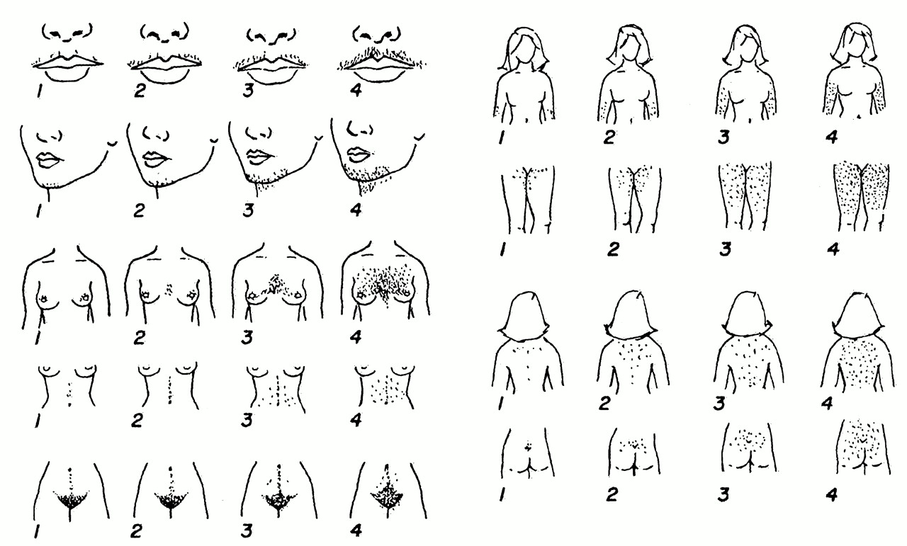

Slide 15
University of Basrah
Al-Zahraa Medical College
Ministry of higher Education
and Scientific Research
4)in women with moderate to severe H(score>15) seek additional signs of hyperandrogenism :
Temporal hair recession ,oily skin, masculine voice, well developed musculature, enlargement of the clitoris, irregular menses, psychological changes e.g heightened libido, aggressiveness, breast tissue atrophy.
5) A thorough abdominal and pelvic examination is important in patients with H because more than half of androgen-secreting adrenal and ovarian tumors are palpable.
6) Examine the skin for acanthosis nigricans, a manifestation of insulin resistance.
7) These patients are usually obese and are at increased risk for atherosclerosis and coronary heart disease.

Slide 16
University of Basrah
Al-Zahraa Medical College
Ministry of higher Education
and Scientific Research
Investigations
1) Serum testosterone H; the most important to assay.
Very high test. levels are likely to be associated with a tumor whereas a very mild elevation is found in benign and idiopathic etiologies .
2)DHEAS :because test. can originate in either the adrenal cortex or the ovary so measurement of elevated levels of DHEAS, an androgen synthesized almost exclusively by the adrenal cortex, can indicate excess adrenal function.
3)17 hydroxyprogesterone :for diagnosis of CAH.

Slide 17
University of Basrah
Al-Zahraa Medical College
Ministry of higher Education
and Scientific Research
4)dexamethasone suppression test :for diagnosis of cushing syndrome.
5)FSH, LH, Prolactin :women with H and amenorrhea of unknown cause should have a serum prolactin and FSH,LH to evaluate for prolactinoma or ovarian dysfunction.
6) screening for diabetes mellitus and hyperlipidemia specially in female with PCOS, obesity or acanthosis nigricans.
7)imaging studies : if indicated by the above findings , ovarian ultrasound and adrenal CT scan or MRI.

Slide 18
University of Basrah
Al-Zahraa Medical College
Ministry of higher Education
and Scientific Research
TREATMENT
The treatment of H begins with a careful explanation about the cause of the problem and reassurance that the patient is not losing her femininity.
Then direct intervention , if possible, is instituted for the underlying disorder.
In some cases cosmetic measures may be sufficient, in others we may need to combine systemic therapy which has a slow onset of effectiveness with the more immediate cosmetic treatment.
Lifestyle changes aiming at weight reduction in women with PCOS.

Slide 19
University of Basrah
Al-Zahraa Medical College
Ministry of higher Education
and Scientific Research
Systemic therapy
These either reduce ovarian or adrenal androgen production or inhibit androgen action in the skin.
1)Glucocorticoids suppress ACTH-dependent adrenal androgen synthesis, have been used in women with adrenal H as in CAH or idiopathic adrenal hyperandrogenism , usually 0.5-1 mg of dexamethasone at bedtime is sufficient to suppress the androgen production.

Slide 20
University of Basrah
Al-Zahraa Medical College
Ministry of higher Education
and Scientific Research
2)Oral contraceptives these are the most widely used drugs to suppress ovarian androgen production, they are probably the first choice for young women with H who do not want to become pregnant.
Estrogens lower circulating androgens
by : a combination of slight inhibition of gonadotrophin secretion and ovarian steroid production and
by : an increase in hepatic production of SHBG resulting in lower free testesterone.

Slide 21
University of Basrah
Al-Zahraa Medical College
Ministry of higher Education
and Scientific Research
Oral contraceptives are inexpensive and they promote regular uterine bleeding, in addition, oral contraceptives can be used in combination with one of the antiandrogens.
Ethinylestradiol + cyproterone acetate ( Diane) licensed in UK for facial hirsutism (not for contraception!)
Medroxyprogesterone acetate:
• if COCP is contraindicated

Slide 22
University of Basrah
Al-Zahraa Medical College
Ministry of higher Education
and Scientific Research

Slide 23
University of Basrah
Al-Zahraa Medical College
Ministry of higher Education
and Scientific Research
3)Cyproterone acetate is an antiandrogen taken in the first 10 days of the cycle in a dose of 50-100 mg, this is usually combined with an oral contraceptive.
4)Spironolactone acts by blocking androgen receptors, it also reduces testosterone production, it is usually given with an oral contraceptive to control the menstrual cycle and to ensure that contraceptive measures are adequate.
Dose 50-100 mg daily .
5)Flutamide is a nonsteroidal selective antiandrogen without progestational, estrogenic, corticoid, or antigonadotropin activity.
Dose 250 mg t.d.s, usually combined with an oral contraceptive.
Flutamide is expensive and has caused fatal hepatitis.

Slide 24
University of Basrah
Al-Zahraa Medical College
Ministry of higher Education
and Scientific Research
6)Finasteride is a 5 alpha-reductase inhibitor approved for the treatment of BPH. No adverse effects have been reported in women, however the main concern is the risk of ambiguous genitalia in male fetuses exposed to the drug.
7)Ketoconazole is an antifungal with antiandrogenic properties, dose is 400 mg daily, used as a last resort in severe H.
Side effect hair loss, dry skin, abdominal pain,hepatotoxicity.
8)Cimetidine may be used in treatment of H.
9)Metformin is an insulin-sensitizing drug used in patients with insulin resistance.

Slide 25
University of Basrah
Al-Zahraa Medical College
Ministry of higher Education
and Scientific Research
Cosmetic measures
Hydrogen peroxide bleaching :this is not suitable for severe H.
Plucking :this can cause skin irritation, folliculitis, scarring and the growth of surrounding hair follicles is stimulated.
Waxing :can cause skin irritation, folliculitis, scarring.
Shaving :this may be psychologically unacceptable.
Chemical depilatories :can cause skin irritation.
Electrolysis :this can be painful and may cause scarring.
Laser therapy is effective but posttreatment hyperpigmentation may occur.

Slide 26
